Slide 1
exceptions
JDBC Database Access

Slide 2
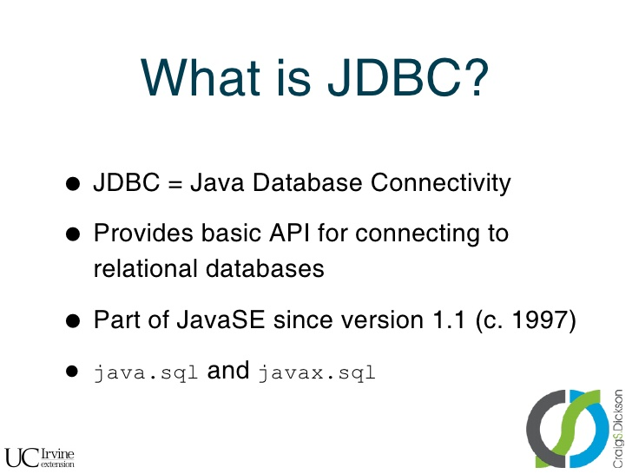

exceptions

Slide 3
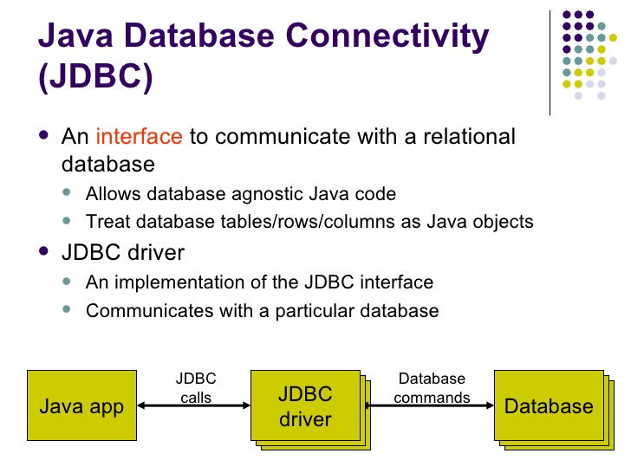
exceptions

Slide 4
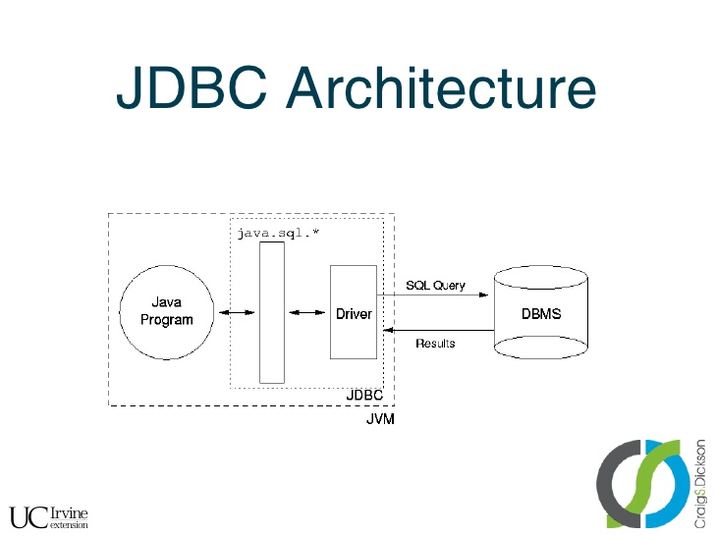
exceptions

Slide 5
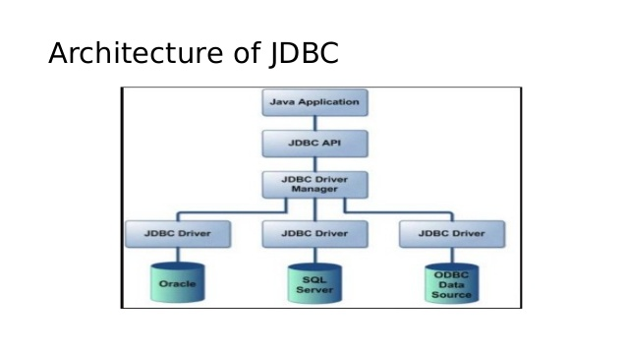
exceptions

Slide 6
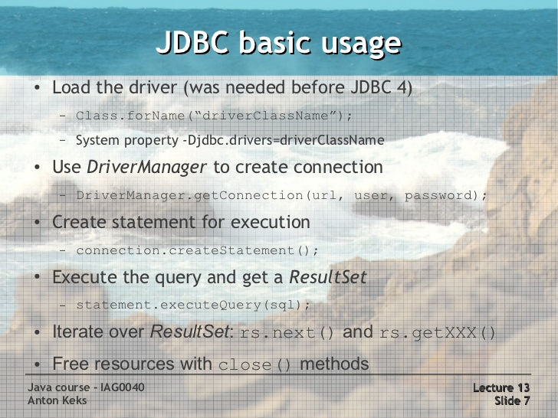
exceptions

Slide 7
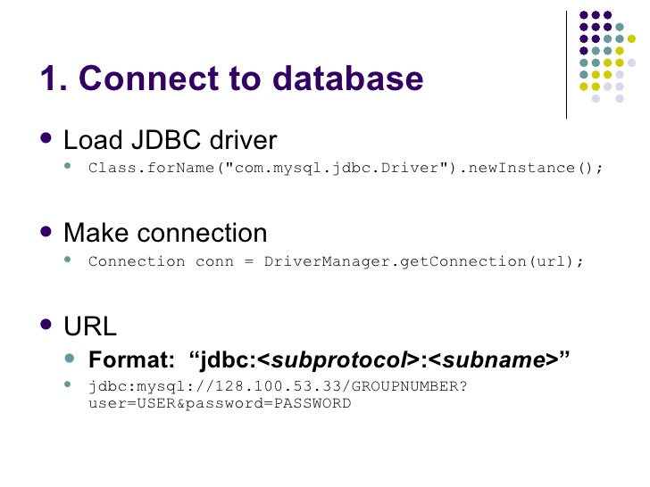
exceptions

Slide 8
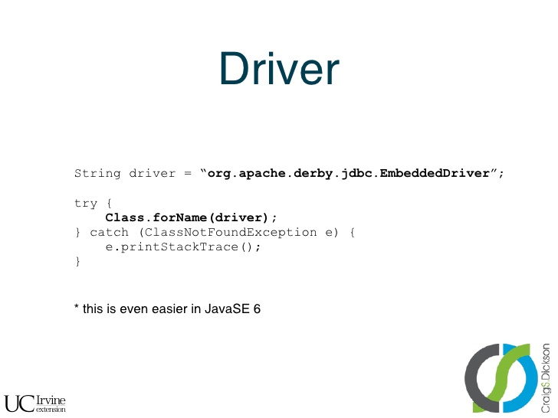
exceptions
Any JDBC 4.0 drivers that are found in your class path are automatically loaded. (However, you must manually load any drivers prior to JDBC 4.0 with the method Class.forName.)

Slide 9
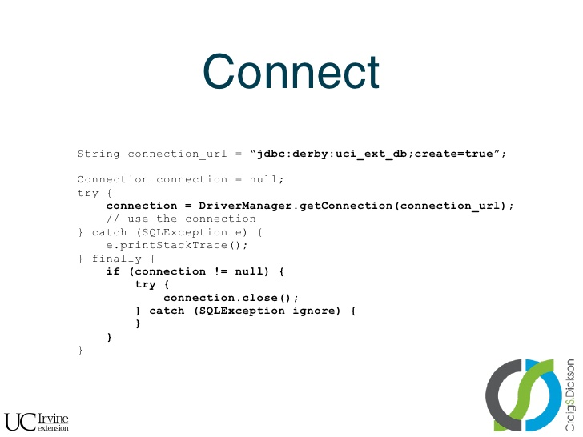
exceptions

Slide 10
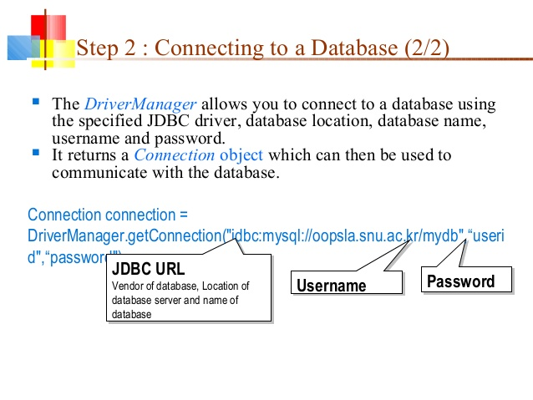
exceptions

Slide 11

exceptions
Database Connection URL’s
For Java DB:
jdbc:derby:[subsubprotocol:][databaseName] [;attribute=value]*
subsubprotocol specifies where Java DB should search for the database, either in a directory, in memory, in a class path, or in a JAR file. It is typically omitted.
databaseName is the name of the database to connect to.
attribute=value represents an optional, semicolon-separated list of attributes. These attributes enable you to instruct Java DB to perform various tasks, including the following:
Create the database specified in the connection URL.
Encrypt the database specified in the connection URL.
Specify directories to store logging and trace information.
Specify a user name and password to connect to the database.
Ex: jdbc:derby:testdb;create=true

Slide 12
exceptions
Database Connection URL’s
For MySQL:
jdbc:mysql://[host][,failoverhost...][:port]/[database][?propertyName1][=propertyValue1][&propertyName2][=propertyValue2]...
host:port is the host name and port number of the computer hosting your database. If not specified, the default values of host and port are 127.0.0.1 and 3306, respectively.
database is the name of the database to connect to. If not specified, a connection is made with no default database.
failover is the name of a standby database (MySQL Connector/J supports failover).
propertyName=propertyValue represents an optional, ampersand-separated list of properties.
Ex: jdbc:mysql://localhost:3306/mysql

Slide 13
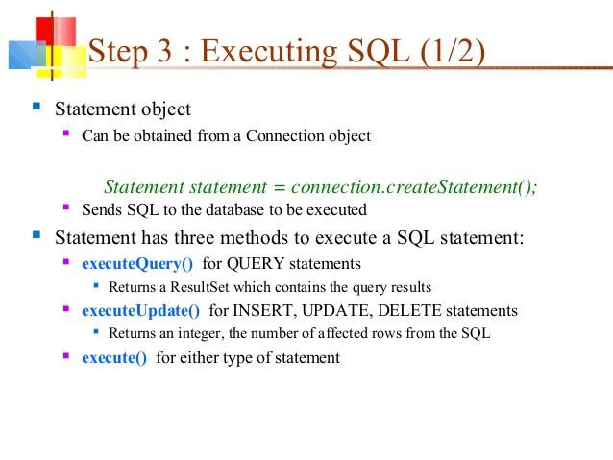
exceptions

Slide 14
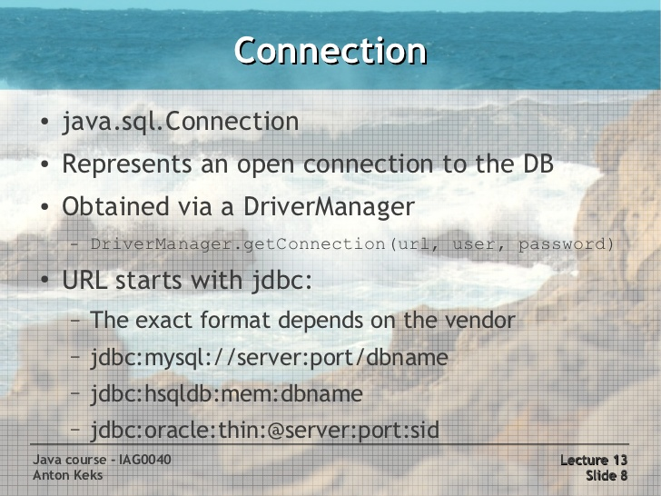
exceptions
Lab22.3: Demonstration JDBC connection to mysql db and query the table.
Lab22.4: Demonstration JDBC connection to mysql db using try with Resource statement.

Slide 15
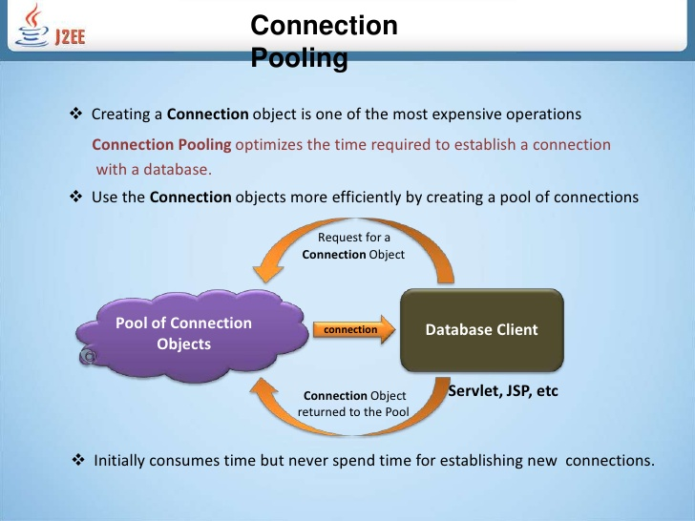
exceptions

Slide 16
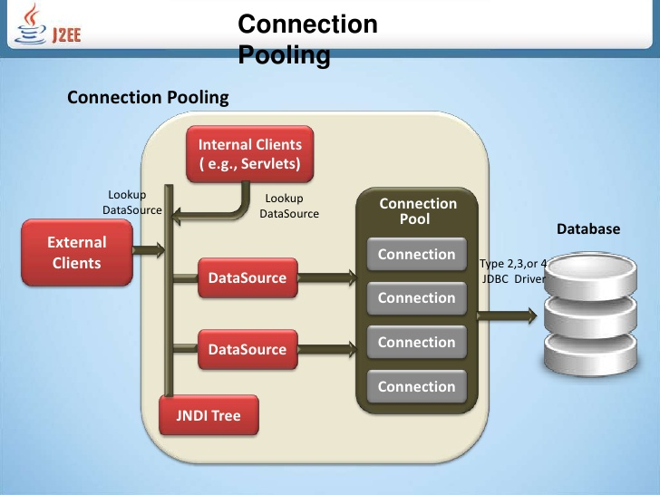
exceptions

Slide 17
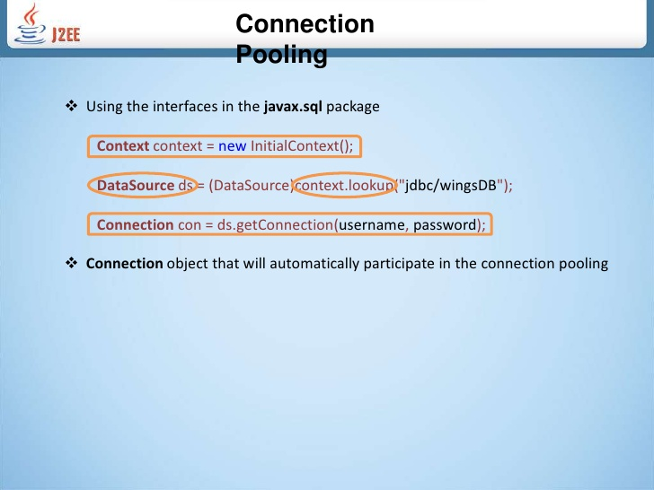
exceptions

Slide 18
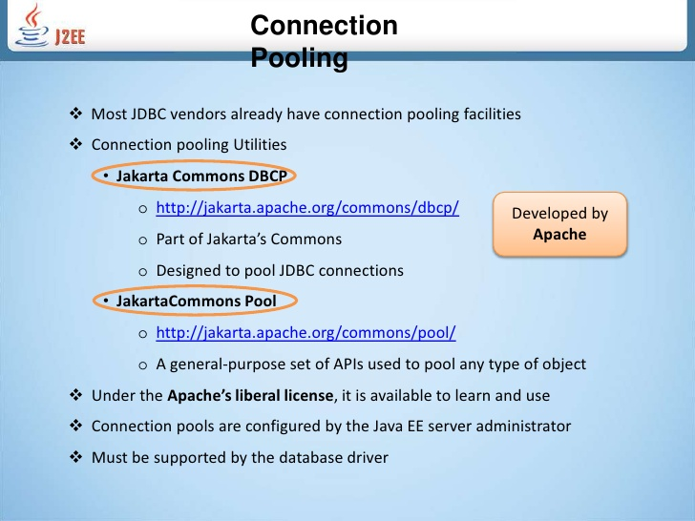
exceptions

Slide 19
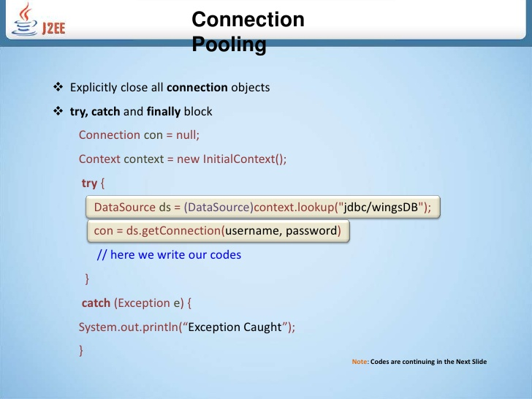
exceptions

Slide 20
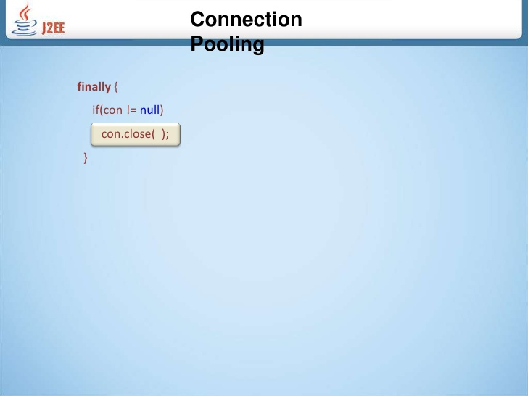
exceptions

Slide 21
exceptions
DataSource
Preferred means of getting a connection to a data source.
Provides connection pooling.
Provides distributed transactions.
A JDBC driver should include at least a basic DataSource implementation (Connection objects that are not pooled or used in distributed transactions).
Provides caching of PreparedStatement for faster processing.
Configure Connection timeout settings.
Centralized logging.
ResultSet maximum size threshold.
Enables code portability.

Slide 22
exceptions
DataSource
Ex:
For Java DB:
org.apache.derby.jdbc.ClientDataSource
For MySQL:
com.mysql.jdbc.jdbc2.optional.MysqlDataSource

Slide 23
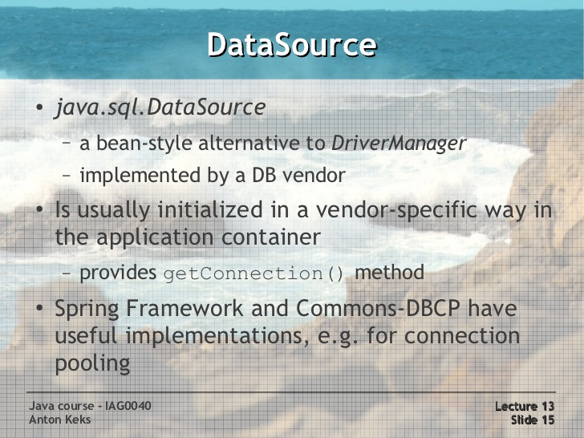
exceptions
Lab22.4: Demonstration JDBC connection to mysql db using DataSource

Slide 24
exceptions
JDBC Exceptions
JDBC throws an instance of SQLException as opposed to Exception.

Slide 25
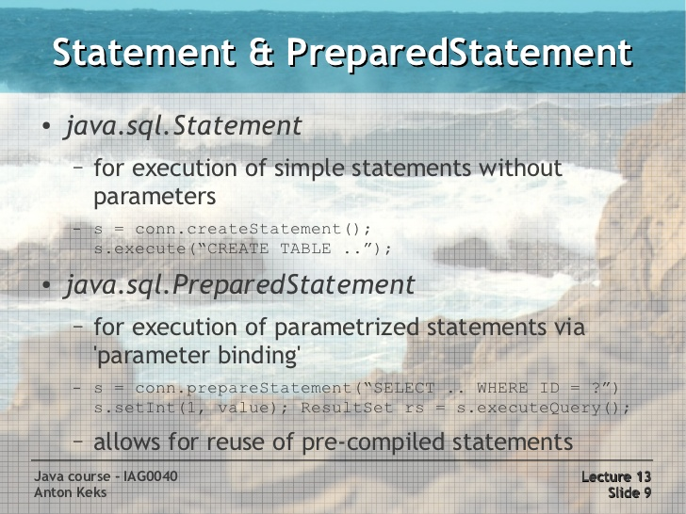
exceptions

Slide 26
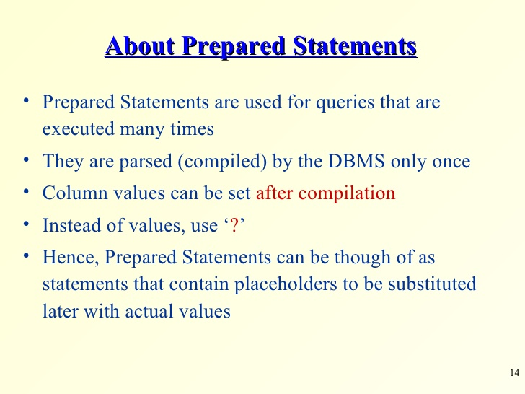
exceptions

Slide 27
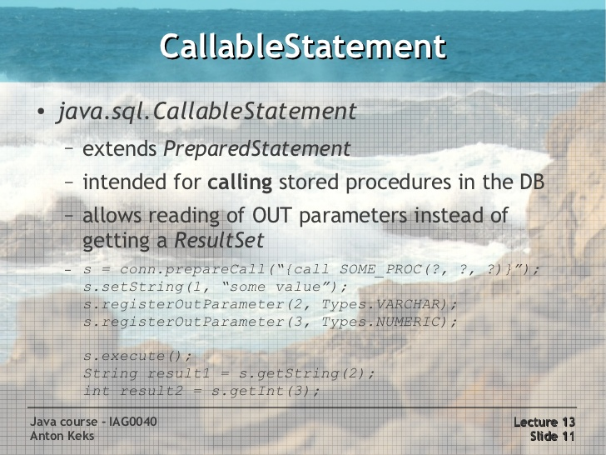
exceptions

Slide 28
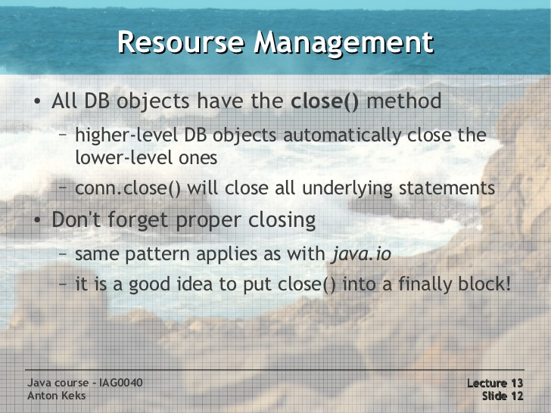
exceptions

Slide 29
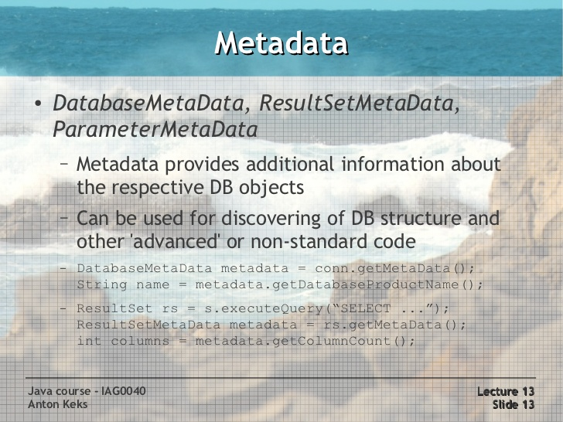
exceptions

Slide 30
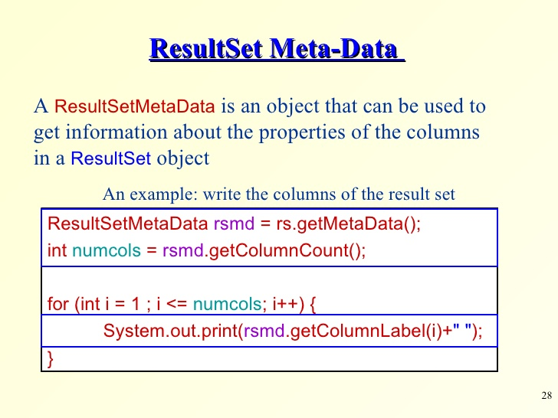
exceptions

Slide 31
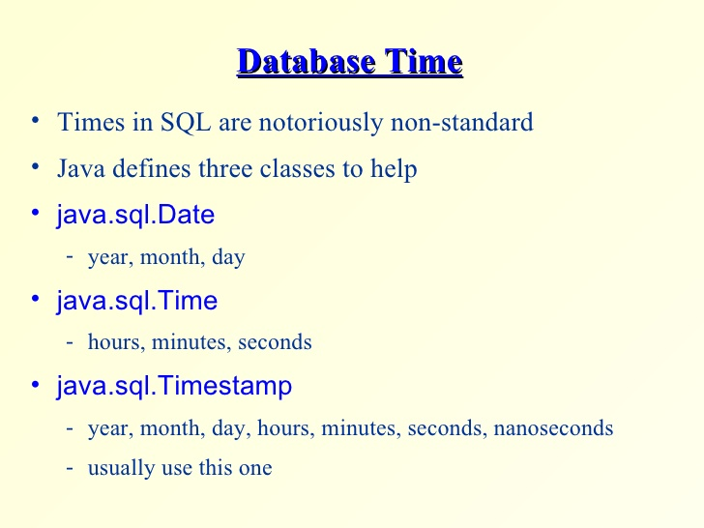
exceptions

Slide 32
exceptions

Slide 33
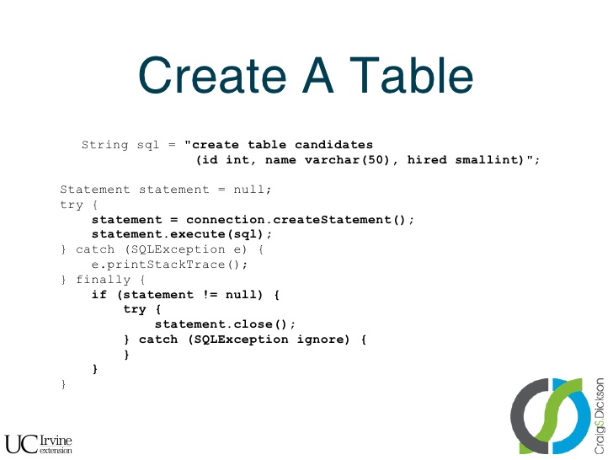
exceptions

Slide 34
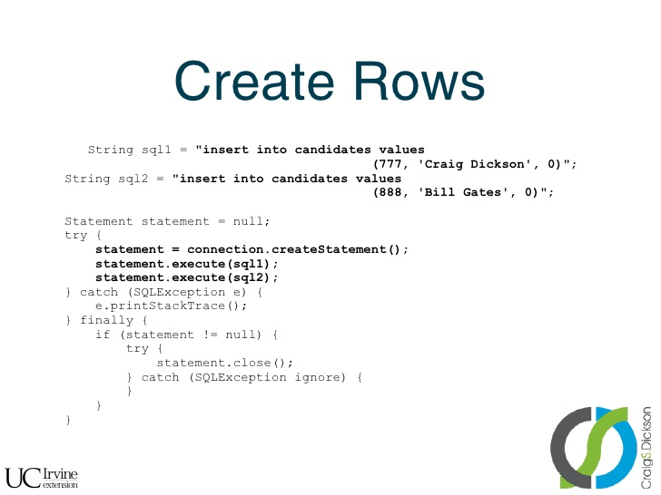
exceptions

Slide 35
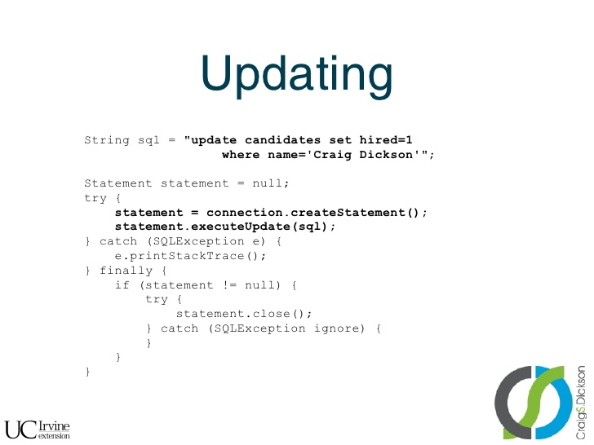
exceptions

Slide 36
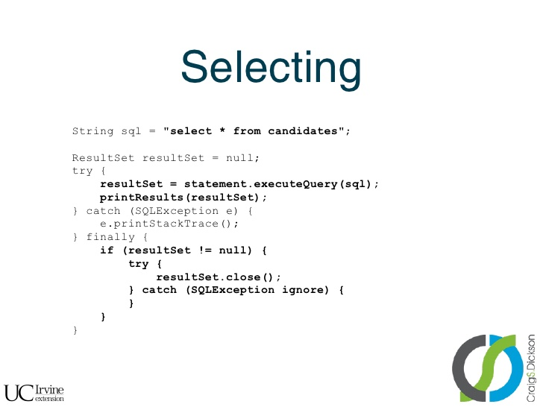
exceptions

Slide 37
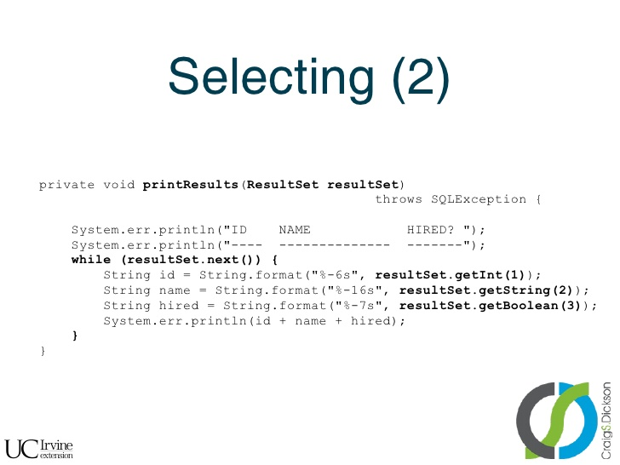
exceptions

Slide 38
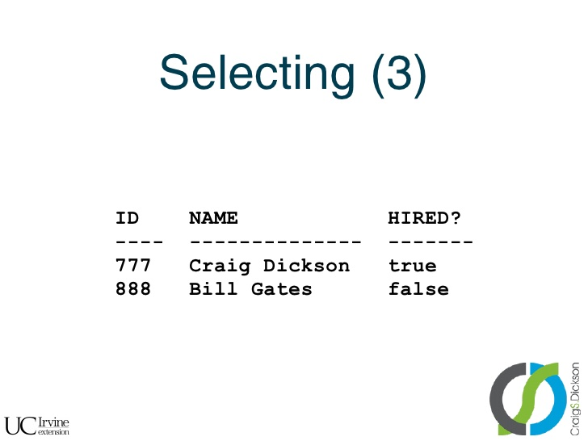
exceptions

Slide 39
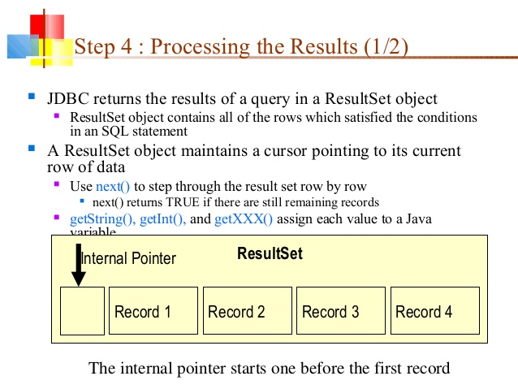
exceptions

Slide 40
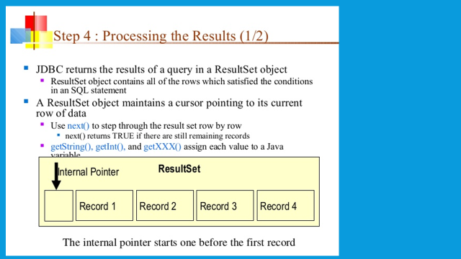
exceptions

Slide 41
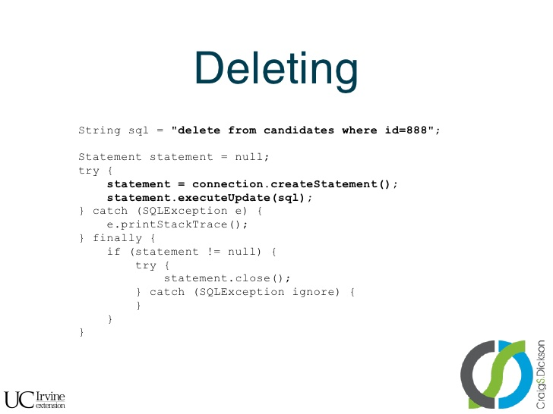
exceptions

Slide 42
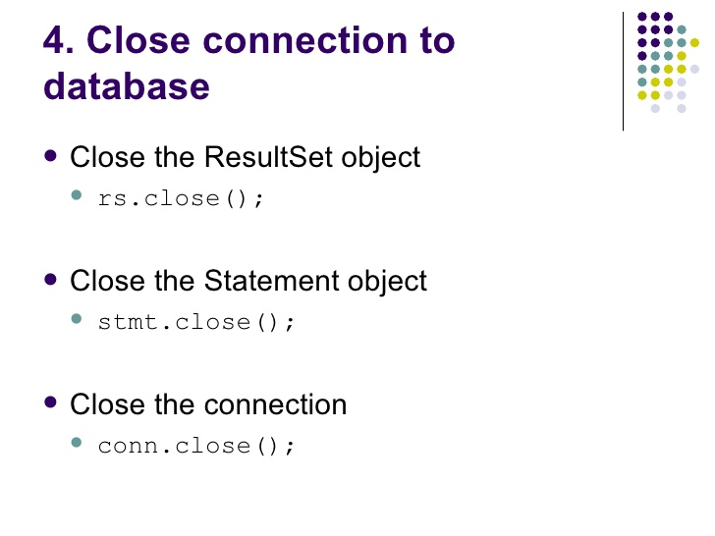
exceptions

Slide 43
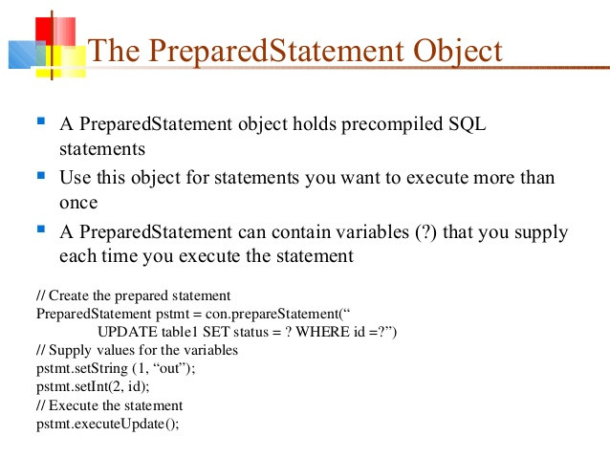
exceptions

Slide 44
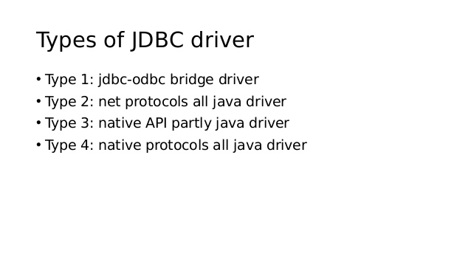
exceptions

Slide 45
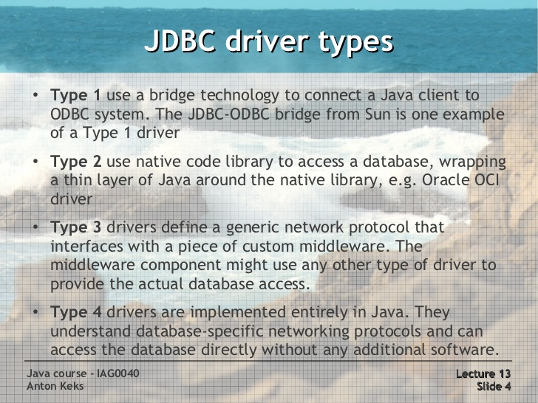
exceptions

Slide 46
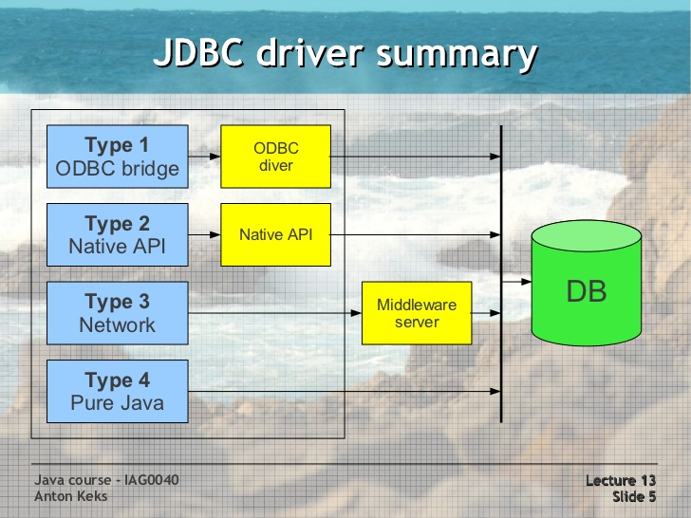
exceptions

Slide 47
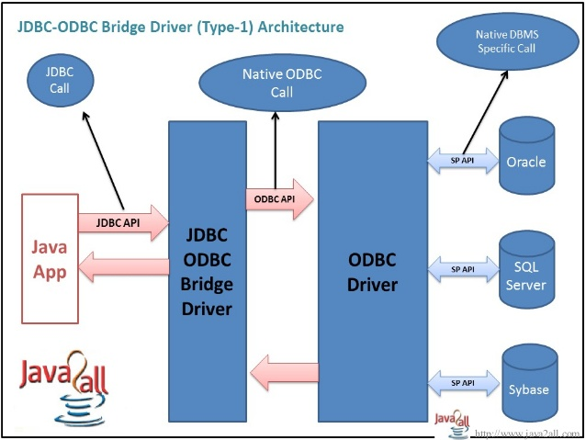
exceptions

Slide 48
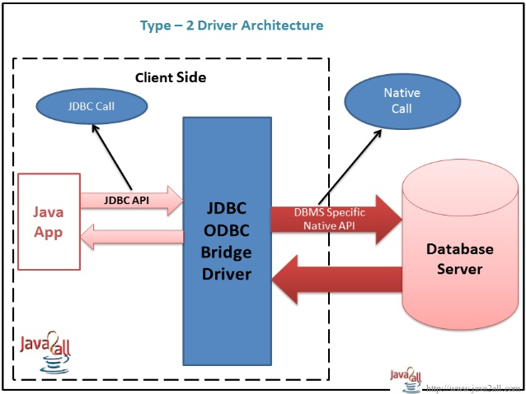
exceptions

Slide 49
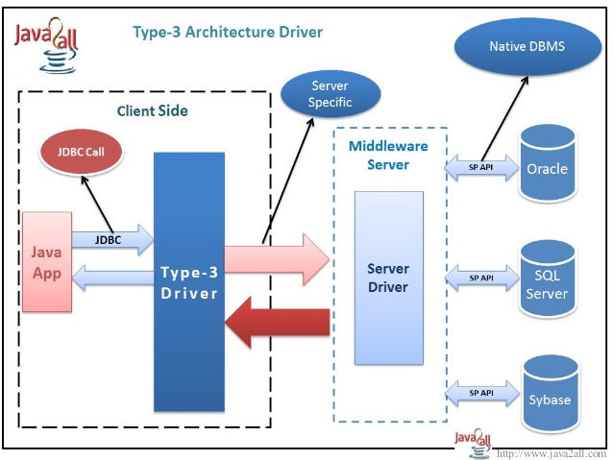
exceptions

Slide 50
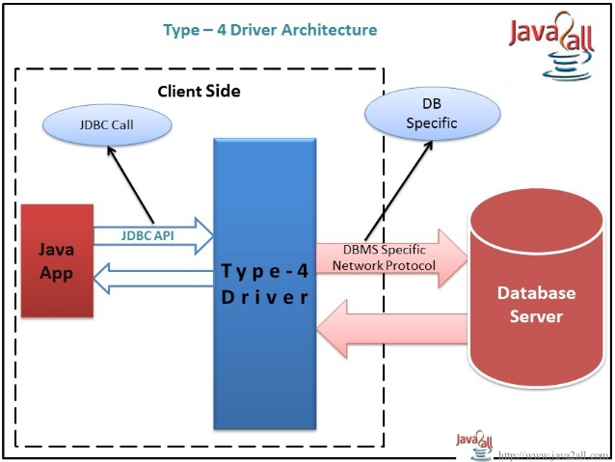
exceptions

Slide 51
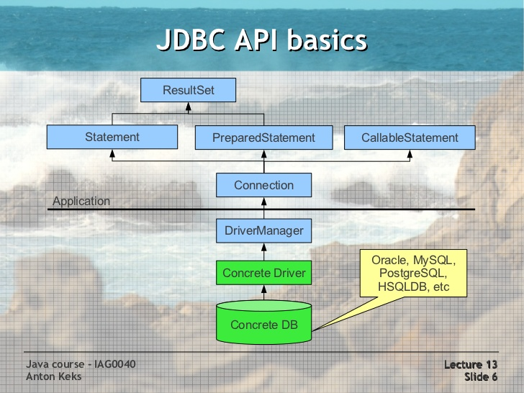
exceptions

Slide 52
exceptions
ResultSet and Cursors
The rows that satisfy the conditions of a query are called the result set.
The number of rows returned in a result set can be zero, one, or many.
A user can access the data in a result set one row at a time, and a cursor provides the means to do that.
A cursor can be thought of as a pointer into a file that contains the rows of the result set, and that pointer has the ability to keep track of which row is currently being accessed.
Most DBMSs create a cursor automatically when a result set is generated.
Result set's cursor can be moved both forward and backward and also allowing it to move to a specified row or to a row whose position is relative to another row.

Slide 53
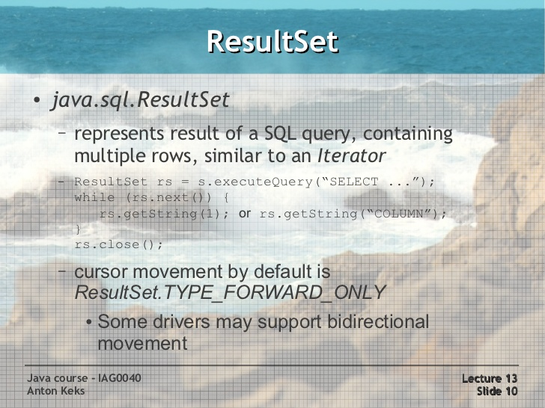
exceptions

Slide 54
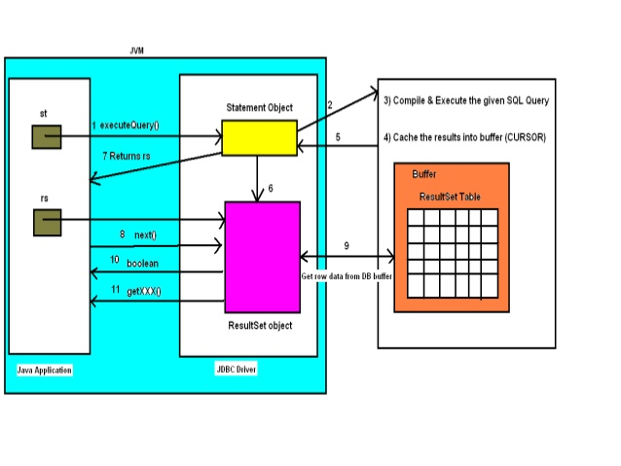
exceptions

Slide 55
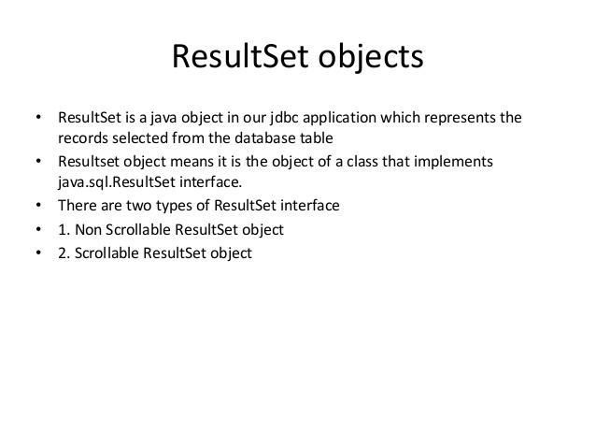
exceptions

Slide 56
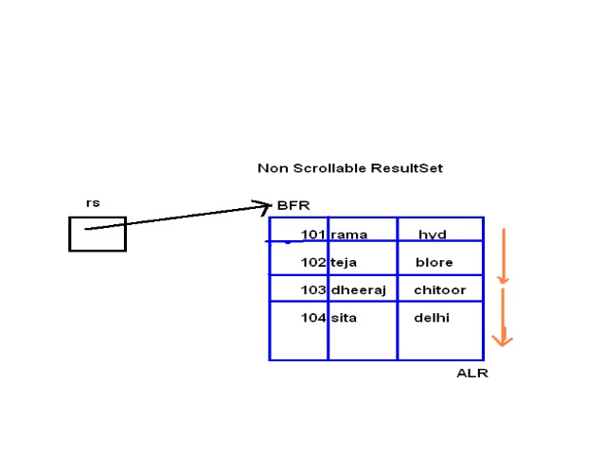
exceptions

Slide 57
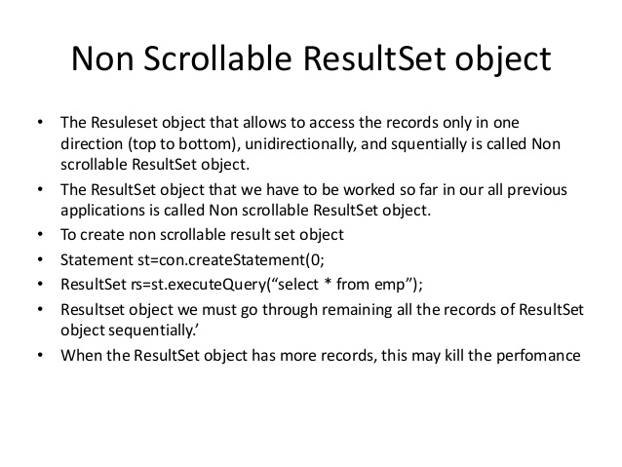
exceptions

Slide 58
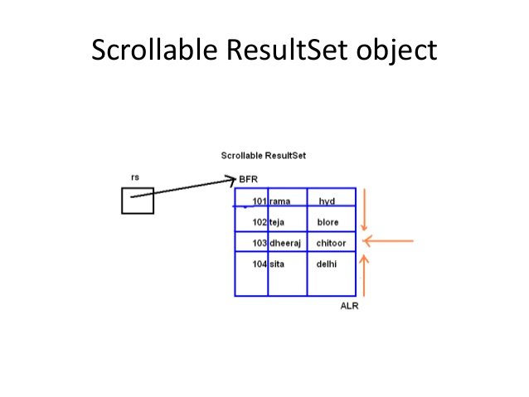
exceptions

Slide 59

exceptions

Slide 60

exceptions

Slide 61

exceptions

Slide 62

exceptions

Slide 63

exceptions

Slide 64
exceptions

Slide 65
exceptions

Slide 66
exceptions

Slide 67
exceptions

Slide 68
exceptions

Slide 69

exceptions

Slide 70

exceptions

Slide 71

exceptions

Slide 72

exceptions

Slide 73

exceptions

Slide 74

exceptions

Slide 75

exceptions

Slide 76

exceptions

Slide 77

exceptions

Slide 78

exceptions

Slide 79

exceptions

Slide 80

exceptions

Slide 81

exceptions

Slide 82

exceptions

Slide 83

exceptions

Slide 84

exceptions

Slide 85
exceptions

Slide 86

exceptions

Slide 87

exceptions

Slide 88

exceptions

Slide 89

exceptions

Slide 90

exceptions

Slide 91

exceptions

Slide 92
exceptions
Transaction Locks:
Lock :
Mechanism that prohibits two transactions from manipulating the same data at the same time.
Table Lock:
Prevents a table from being dropped if there is an uncommitted transaction on that table.
Row Lock:
A row lock prevents two transactions from modifying the same row, or it prevents one transaction from selecting a row while another transaction is still modifying it.

Slide 93

exceptions

Slide 94
exceptions

Slide 95
exceptions

Slide 96
exceptions
Running Eclipse

Slide 97
exceptions
References:
http://www.slideshare.net/itsec/jdbc-tutorial
http://www.slideshare.net/myrajendra/interface-result-set
http://www.slideshare.net/antonkeks/java-course-13-jdbc-db-access
http://www.slideshare.net/itsec/jdbc-java-database-connectivity-4071670
http://www.slideshare.net/becoolever/connection-pooling
http://www.journaldev.com/2509/jdbc-datasource-example-oracle-mysql-and-apache-dbcp-tutorial

Slide 98
Java - miscellaneous
Type Comparison Operator instanceof
The instanceof operator compares an object to a specified type.
You can use it to test if an object is an instance of a class, an instance of a subclass, or an instance of a class that implements a particular interface
Classes implementing interfaces
class MyClass extends MySuperClass implements YourInterface {
// field, constructor, and
// method declarations
}

Slide 99
Java - miscellaneous
Varargs – Specifying Arbitrary number of arguments
public Polygon polygonFrom(Point... corners) {
int numberOfSides = corners.length;
double squareOfSide1, lengthOfSide1;
squareOfSide1 = (corners[1].x - corners[0].x)
* (corners[1].x - corners[0].x)
+ (corners[1].y - corners[0].y)
* (corners[1].y - corners[0].y);
lengthOfSide1 = Math.sqrt(squareOfSide1);
// more method body code follows that creates and returns a
// polygon connecting the Points
}
You will most commonly see varargs with the printing methods; for example, this printf method:
public PrintStream printf(String format, Object... args)
allows you to print an arbitrary number of objects. It can be called like this:
System.out.printf("%s: %d, %s%n", name, idnum, address);

Slide 100

Java - miscellaneous
Returning a Class or Interface
When a method uses a class name as its return type the class of the type of the returned object must be either a subclass of, or the exact class of, the return type.
public Number returnANumber() {
...
}
The returnANumber method can return an ImaginaryNumber but not an Object. ImaginaryNumber is a Number because it's a subclass of Number. However, an Object is not necessarily a Number — it could be a String or another type

Slide 101
Advanced java
Garbage collection
JDBC
Lambda expressions
Annotations
Aggregate operations on collection using Lambarda expression.
Java streaming
Blocking queue
Aggregate operations
Autoboxing and unboxing

Slide 102
https://docs.oracle.com/javase/tutorial/reallybigindex.html
http://www.slideshare.net/EdurekaIN/java-class-3
http://www.slideshare.net/abdurrehmanabdurrehman391/variables-and-data-types-by-sir-khalid
http://www.slideshare.net/abdurrehmanabdurrehman391/java-advancedoop
http://www.slideshare.net/MindfireSolutions/java-garbage-collection-how-it-works?next_slideshow=1
http://www.slideshare.net/arnold7490/unit-4-java
http://www.slideshare.net/arnold7490/unit-3-java?next_slideshow=1
http://www.slideshare.net/tushardesarda/java-tutorial-3
http://www.slideshare.net/muralidhar9e/java-exception-handling-ppt
http://www.slideshare.net/emprovise/2-javabasics
http://www.slideshare.net/AllanHuang/java-new-evolution
http://www.slideshare.net/antonkeks/4-collections
http://www.slideshare.net/andreaiacono/java8-39841939 - Java8 features
http://www.slideshare.net/AbhishekKhune/07-java-collection
http://www.slideshare.net/shahjahan786/generics-27960064 - Generics
http://www.slideshare.net/caroljmcdonald/java-generics-2485138?next_slideshow=1

Slide 103
http://www.slideshare.net/KavitaGanesan/is-66154415-kavitaganesanv2 - Strings
http://www.slideshare.net/antonkeks/10-threads - Threads
http://www.slideshare.net/BenjDelMundo/java-thread-synchronization - Synchronization
http://www.slideshare.net/javaonkar/thread-concurrancy - Synchronization
http://www.slideshare.net/lineking/io-package - Basic IO
http://new.51cto.com – Buffered streams.
http://www.slideshare.net/EmertxeSlides/010-core-javaiofundamentals - IO
http://www.slideshare.net/martyhall/file-io-in-java-8-applying-the-power-of-streams - File IO
http://www.slideshare.net/boulderjug/55-things-in-java-7 - File IO

